Slide 1
Unsupervised Learners: Forecasting Best Buy’s Daily Low-Selling SKU’s
Zachary Labkovski, Jonathan Mager, Daniel Nagle, & Nik Patel

Slide 2
Our Process
Data Cleaning and Setup
Model Implementation
Validation

Slide 3
Data Cleaning & Setup

Slide 4
Data Setup
ARIMA
Created dictionary of DataFrames with SKU as key, and df as value
Converted column data types to datetime, int, float, dummy variables (for categorical)
Exponential Smoothing
Replaced missing data with the retail price and difference between competitor/promo and retail variables created
Turned categorical variables into binary dummy variables
Separated data by SKU ID
Ridge Regression
Created new column with 'Discount' that evaluated found difference between retail and promo price given there was a promotion (0 if no promo price)
Needed to convert prices in the thousands to numeric values by removing commas
Created categorical variables of day of the week and month of the year from 'SALES_DATE'
Turned those categorical variables into several binary variables using pd.get_dummies

Slide 5

Methodology: It Depends

Slide 6
Modeling Methodology
ARIMA
+ Works well with time-series data, particularly in short term time horizons
- Computationally expensive, need to tune parameters
XGBoost
Too computationally intensive; quickly moved in another direction
Exponential Smoothing
+ Recent observations have more weight
- Lags behind actual trends
Ridge Regression
+ Alpha value constrains the coefficients compared to simple linear regression
- Wants to extremely overvalue year as a numerical value, which causes overprediction

Slide 7
Exponential Smoothing and Regression
Data Input
Exponential Smoothing: SKU 1
Exponential Smoothing: SKU 3
…
Regression Model: 1 day difference
Regression Model: 2 day difference
…
Exponential Smoothing: SKU 2
…
Regression Model: 1 day difference
Regression Model: 2 day difference
Regression Model: 6 day difference
Regression Model: 1 day difference
Regression Model: 2 day difference
…
Regression Model: 2 day difference
...
Regression Model: 6 day difference
Regression Model: 6 day difference
Regression Model: 6 day difference
Regression Model: 1 day difference
Trained many different models to predict the baseline (Exponential Smoothing)
Trained regression models to predict the difference from the baseline

Slide 8
Model Results

Slide 9
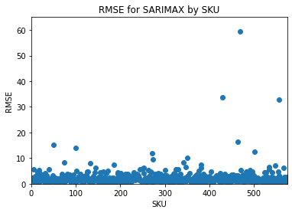
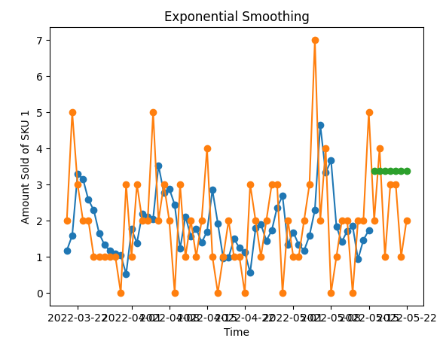
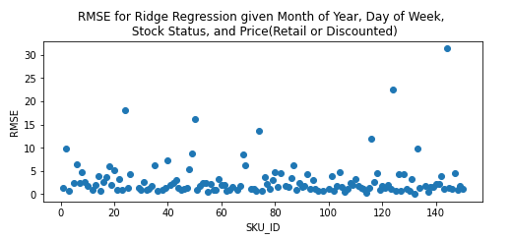
Results
RMSE from ARIMA model = 4.389
Time ≈ 15 minutes
RMSE from Exponential Smoothing model = 4.782
RMSE of 20 when regression was added on top
Time ≈ <30 seconds
RMSE from Ridge Regression model = 5.126
Time ≈ 30 seconds

Slide 10
Final Model

Slide 11
ARIMA Model for each SKU
"SARIMAX" Model:
Seasonal Auto-Regressive Integrated Moving Average with eXogenous features
Exogenous features: retail price, day of week, day of month, year, month, "promo", "out of stock"
"promo", "out of stock": dummy variables
3 sets of parameters:
539 total SKUs in validation set
488 used (p, d, q) = (1, 0, 0) aka First-Order Autoregressive Model
34 used (p, d, q) = (2, 1, 1)
17 used (p, d, q) = (0, 1, 1) aka Simple Exponential Smoothing
Greatest challenge: tuning parameters
Grid Search too time consuming

Slide 12
Thank You

